Slide 1
ENDOMETRIOSIS
Misunderstood and Stigmatised

Slide 2
Basic information about endometriosis

Slide 3
What is endometriosis?
Endometriosis is a condition in which tissue similar to the lining inside the uterus (called “the endometrium”), is found outside the uterus, where it induces a chronic inflammatory reaction that may result in scar tissue. It is primarily found on the pelvic peritoneum, on the ovaries, in the recto-vaginal septum, on the bladder, and bowel.

Slide 4

Who is affected by endometriosis?
Endometriosis affects an estimated 1 in 10 women during their reproductive years (ie. usually between the ages of 15 to 49), which is approximately 176 million women in the world.

Slide 5
Endometriosis symptoms
painful periods painful ovulation
general fatigue
heavy bleeding
chronic pelvic pain
general fatigue

Slide 6
How is endometriosis diagnosed?
Endometriosis is diagnosed by a laparoscopy, which is a surgical procedure in which a small incision is made in the lower abdomen and a thin, lighted tube is inserted through the incision into the pelvic cavity. This allows the doctor to see the endometrial tissue and to confirm the diagnosis of endometriosis.

Slide 7

Is endometriosis a cancer?
No, endometriosis is not a cancer.
Cancer is a disease in which cells in the body grow out of control.
Endometriosis is a condition in which tissue that normally grows inside the uterus grows outside of it.
Some research suggests that women with endometriosis may be at an increased risk for certain types of cancer, such as ovarian cancer.

Slide 8
Does endometriosis connect to other medical conditions?
There is a connection between endometriosis and other diseases. For example, endometriosis is often diagnosed in women with infertility. In addition, this disease is often accompanied by fibroids, polycystic ovary syndrome, and adenomyosis.

Slide 9
Is endometriosis inherited?
There is no definitive answer to this question as the causes of endometriosis are not fully understood. However, there is some evidence to suggest that endometriosis may have a genetic component, as it is more common in women who have a family history of the condition.
Some research show that first-degree relatives of women with this disease have a seven-fold risk of developing endometriosis.

Slide 10
Does endometriosis cause infertility?
There is no one answer to this question as each individual's experience with endometriosis is unique. Some women with endometriosis are able to conceive and carry a pregnancy to term without any difficulty, while others may experience fertility issues.
Research shows that nearly 50% of women diagnosed with endometriosis have difficulty getting pregnant.

Slide 11
Is there an effective cure for endometriosis?
Unfortunately not yet. However, there are treatments that can reduce symptoms effectively by combining long-term treatment.
Pregnancy may relieve symptoms but is not a cure for the disease. In most cases, endometriosis will return after giving birth and stopping breastfeeding.
Hysterectomy, with surgical removal of all the disease at the same time, may relieve symptoms, but it is not be a ‘definitive cure’ either.
Removal of the ovaries at the same time as a hysterectomy is performed increases the chances of pain relief but also results in an immediate menopause.

Slide 12
The cause

Slide 13
The causes of endometriosis are not fully understood.
Endometriosis is an estrogen-dependent disease, and the development of endometriosis is associated with a number of hormonal and immunologic factors.
There are several theories about how endometriosis develops, but the most likely explanation is a combination of retrograde menstruation and coelomic metaplasia.
In retrograde menstruation, menstrual blood and tissue flow backward through the fallopian tubes and into the pelvic cavity.
This backward flow is thought to expose the peritoneal surface to endometrial cells, which then implant and grow.
Coelomic metaplasia is a process in which the cells lining the peritoneum (the membrane that covers the abdominal cavity and organs) change into endometrial-like cells.
These metaplastic cells may then respond to hormonal stimuli and grow into endometriosis lesions.

Slide 14
The causes of endometriosis are not fully understood
Endometriosis is an estrogen-dependent disease, and the development of endometriosis is associated with a number of hormonal and immunologic factors.
There are several theories about how endometriosis develops, but the most likely explanation is a combination of retrograde menstruation and coelomic metaplasia.

Slide 15
The retrograde menstruation
In retrograde menstruation, menstrual blood and tissue flow backward through the fallopian tubes and into the pelvic cavity.
This backward flow is thought to expose the peritoneal surface to endometrial cells, which then implant and grow.

Slide 16
The coelomic metaplasia
Coelomic metaplasia is a process in which the cells lining the peritoneum (the membrane that covers the abdominal cavity and organs) change into endometrial-like cells.
These metaplastic cells may then respond to hormonal stimuli and grow into endometriosis lesions.

Slide 17
Other possible causes of endometriosis

Slide 18
Hormonal factors
Endometriosis is thought to be associated with high levels of estrogen.
Estrogen promotes the growth of endometrial tissue, and the ovaries produce more estrogen during the first half of the menstrual cycle.
This may explain why endometriosis is more likely to occur during a woman's reproductive years.

Slide 19
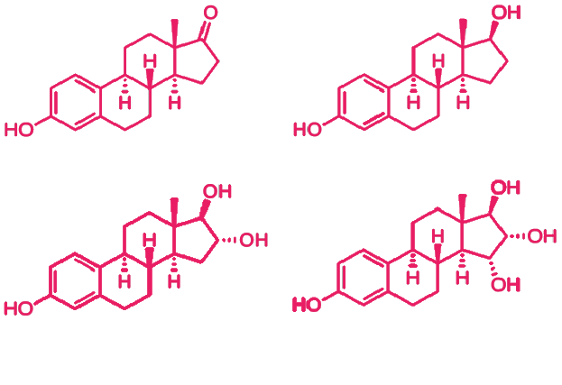
Estrogen is not bad
The primary role of estrogen in the female body is to develop and maintain the female reproductive system and secondary sex characteristics.

Slide 20
Immune system problems
Some research suggests that the immune system may play a role in the development of endometriosis.
In women with endometriosis, the immune system may not be able to effectively remove endometrial tissue that has grown outside the uterus.
This may allow endometrial tissue to grow and spread.

Slide 21
Genetic factors
There may be a genetic component to endometriosis.
The disorder seems to run in families, and women with a family history of endometriosis are more likely to develop the condition.
However, the specific genes involved in endometriosis are not known.

Slide 22
Surgical factors
Surgical procedures that involve the removal of the uterus (hysterectomy) or ovaries may increase the risk of endometriosis.
This may be due to the surgical trauma, which can cause endometrial tissue to be deposited in other areas of the body.

Slide 23
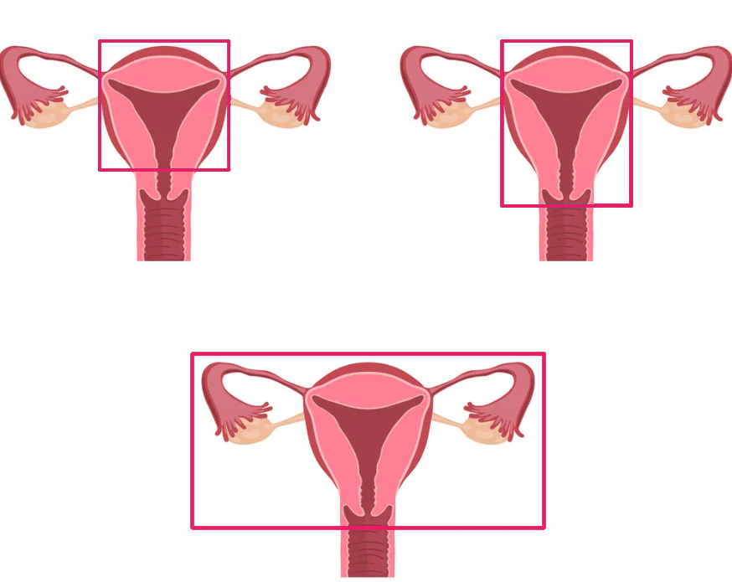
Partial hysterectomy
Total hysterectomy
Radical hysterectomy

Slide 24
What research is currently being done?

Slide 25
Research related to new drugs
Some of the research being done on new drugs for the treatment of endometriosis includes investigating the efficacy of different medication regimens, exploring new drug delivery methods, and testing new drugs that are currently in development.

Slide 26
Research related to surgical techniques
Some of the research being done on surgical techniques for the treatment of endometriosis includes investigating new minimally invasive surgical techniques, testing the efficacy of different surgical approaches, and exploring new ways to optimize surgical outcomes.

Slide 27
Research related to the role of diet and lifestyle
Some of the research being done on the role of diet and lifestyle in the treatment of endometriosis includes investigating the link between diet and endometriosis, exploring the role of stress in the development and progression of endometriosis, and testing different lifestyle interventions for the management of endometriosis.

